Slide 1

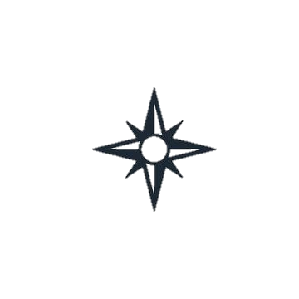
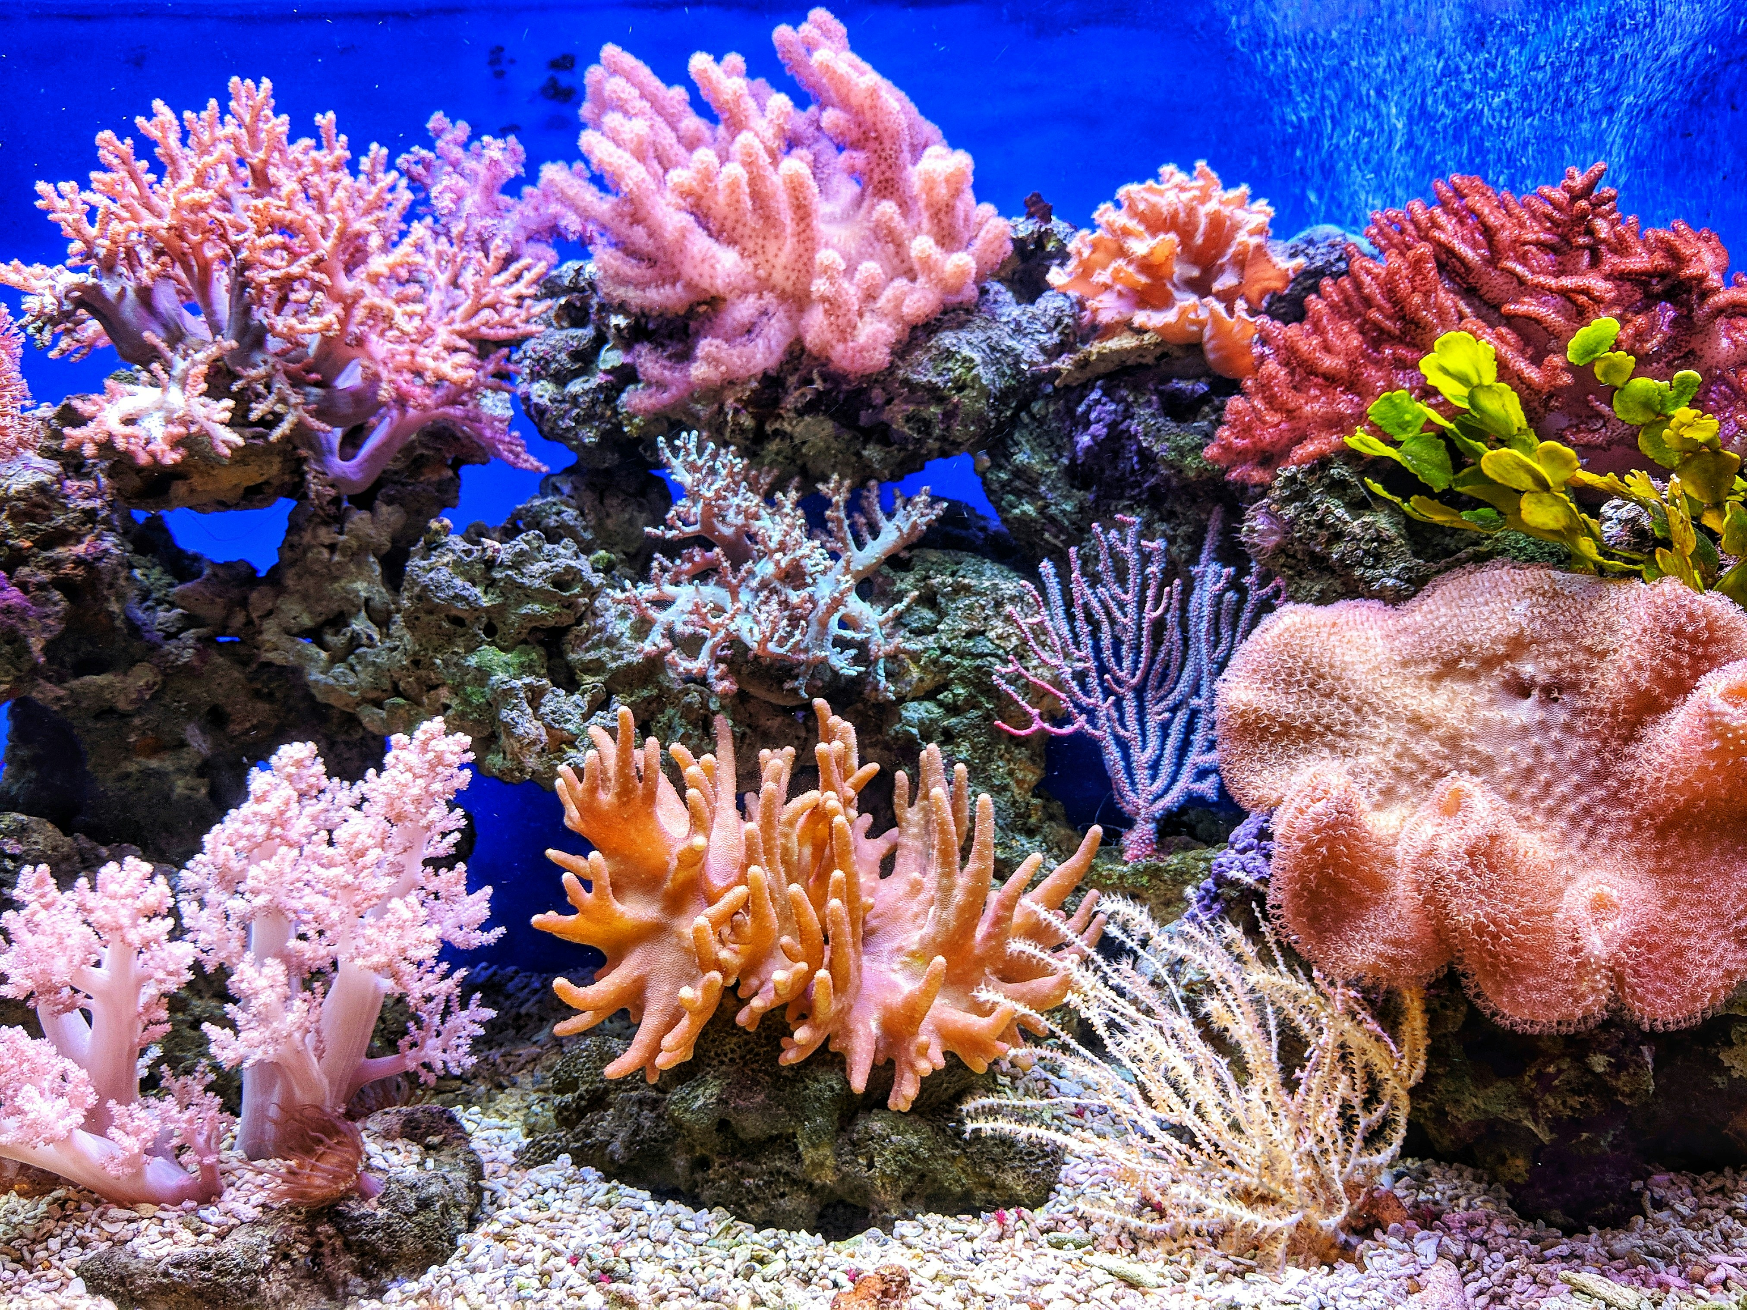
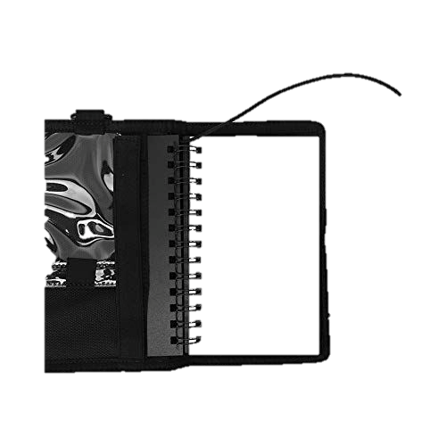
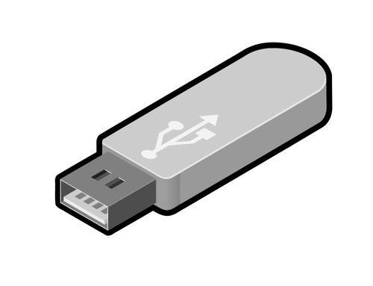
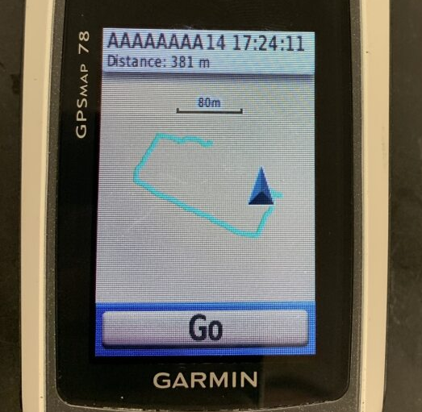

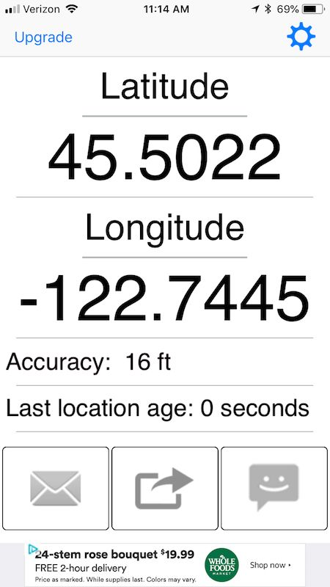
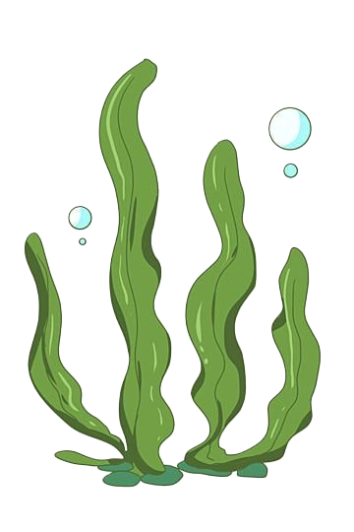
Team 520: Underwater Diver GPS Correction
Team: J. Baumann, N. Boggess, C. Carlson, M. Jadush, M. Jean-Baptiste, A. Snell
Sponsor: Andrew Rassweiler, Ph.D Manager: Shayne McConomy, Ph.D Advisor: Jonathan Clark, Ph.D
The objective of this project is to create a system capable of recording a diver’s position while submerged.
Background
Procedure
GPS is incapable of penetrating through water. It relies on radio waves which decay rapidly in liquid.
The purpose is to pinpoint the location of sick coral reefs in Bonaire.
Originally, a GPS in a Pelican case was attached to the diver with a dive line.
The Previous system has an error of 10+ m.
Calibrate the compass and ensure a proper seal on waterproof systems before diving.
Researcher marks time, depth and length when sick coral is spotted.
After dive, data is exported to software.
Researcher inputs time and length into software.
Position data is received.
Results
Key Goals
The system will be able to reliably work at a depth underwater up to 10 m.
It will pinpoint the diver's position within a 3 m radius.
The system will be portable, capable of launching from the shore, and require minimal setup.
Accuracy Data

Slide 2
Team 520: Underwater Diver GPS Correction
Team: J. Baumann, N. Boggess, C. Carlson, M. Jadush, M. Jean-Baptiste, A. Snell
The objective of this project is to create a system capable of recording a diver’s position while submerged.
Background:
Procedure
GPS is incapable of penetrating through water. It relies on radio waves which decay rapidly in liquid.
The purpose is to pinpoint the location of sick coral reefs in Bonaire.
Originally, a GPS in a Pelican case was attached to the diver with a dive line.
The Previous system has an error of 10+ m.
Calibrate the compass and ensure a proper seal on waterproof systems before diving.
Researcher marks time and length when sick coral is spotted.
After dive, data is exported to software.
Researcher inputs time and length into software.
Position data is received.
Future Work
Key Goals:
Order remaining parts and begin assembly.
Perform testing in the ocean.
Make adjustments based on the results.
The system will be able to reliably work at a depth underwater up to 10 m.
It will pinpoint the diver's position within a 3 m radius.
The system will be portable, capable of launching from the shore, and require minimal setup.
Acknowledgements
Sponsor: Andrew Rassweiler, Ph.D.
Advisors: Johnathan Clark, Ph.D.
Manager: Shayne McConomy, Ph.D.

Slide 3

Team 520: Underwater Diver GPS Correction
Team: J. Baumann, N. Boggess, C. Carlson, M. Jadush, M. Jean-Baptiste, A. Snell
The objective of this project is to create a system capable of recording a diver’s position while submerged.
Background:
Procedure
GPS is incapable of penetrating through water. It relies on radio waves which decay rapidly in liquid.
The purpose is to pinpoint the location of sick coral reefs in Bonaire.
Originally, a GPS in a Pelican case was attached to the diver with a dive line.
The Previous system has an error of 10+ m.
Key Goals:
The system will be able to reliably work at a depth underwater up to 10 m.
It will pinpoint the diver's position within a 3 m radius.
The system will be portable, capable of launching from the shore, and require minimal setup.
Calibrate the compass and ensure a proper seal on waterproof systems before diving.
Researcher marks time and length when sick coral is spotted.
After dive, data is exported to software.
Researcher inputs time and length into software.
Position data is received.
Future Work
Order remaining parts and begin assembly.
Perform testing in the ocean.
Make adjustments based on the results.
Acknowledgements
Sponsor: Andrew Rassweiler, Ph.D.
Advisors: Johnathan Clark, Ph.D.
Manager: Shayne McConomy, Ph.D.

Slide 4
Team 520: Underwater Diver GPS Correction
Team: J. Baumann, N. Boggess, C. Carlson, M. Jadush, M. Jean-Baptiste, A. Snell
The objective of this project is to create a system capable of recording a diver’s position while submerged.
Background
Procedure
GPS is incapable of penetrating through water. It relies on radio waves which decay rapidly in liquid.
The purpose is to pinpoint the location of sick coral while diving in Bonaire.
Originally, a GPS in a Pelican case was attached to the diver with a dive line.
The Previous system has an error of 10+ m.
Calibrate the compass and ensure a proper seal on waterproof systems before diving.
Researcher marks time and length when sick coral is spotted.
After dive, data is exported to software.
Researcher inputs time and length into software.
Position data is received.
Key Goals
The system will be able to reliably work at a depth underwater up to 10 m.
It will pinpoint the diver's position within a 3 m radius.
The system will be portable, capable of launching from the shore, and require minimal setup.
Acknowledgements
Sponsor: Andrew Rassweiler, Ph.D.
Advisors: Johnathan Clark, Ph.D.
Manager: Shayne McConomy, Ph.D.

Slide 5

Team 520: Underwater Diver GPS Correction
Team: J. Baumann, N. Boggess, C. Carlson, M. Jadush, M. Jean-Baptiste, A. Snell
Sponsor: Andrew Rassweiler, Ph.D Manager: Shayne McConomy, Ph.D Advisor: Jonathan Clark, Ph.D
The objective of this project is to create a system capable of recording a diver’s position while submerged.
Introduction
Procedure
GPS is incapable of penetrating through water. It relies on radio waves which decay rapidly in liquid.
The purpose is to pinpoint the location of sick coral while diving in Bonaire.
Originally, a GPS in a Pelican case was attached to the diver with a dive line.
The Previous system has an error of 10+ m.
Goals
The system will be able to reliably work at a depth underwater up to 10 m.​
It will pinpoint the diver's position within a 3 m radius.​
The system will be portable, capable of launching from the shore, and require minimal setup.

